Slide 1
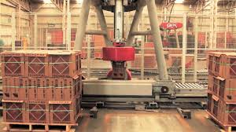
Processing of ceramics
Alumno: Emmanuel Serrato Macias
Matricula: 1766621
Carrera: IMA

Slide 2
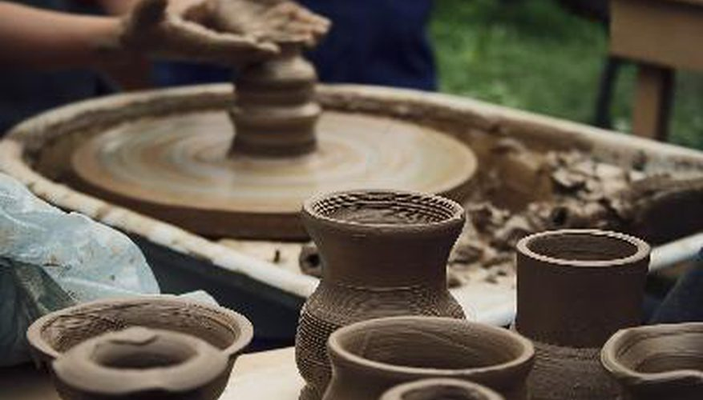
PROCESSED OF THE CERAMICS
Most traditional and technical ceramic products are manufactured by compacting powders or particles in materials that are then heated to enormous temperatures to bond the particles together. The basic stages for the processing of ceramics by particle agglomeration are:

Slide 3
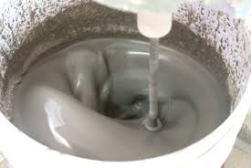
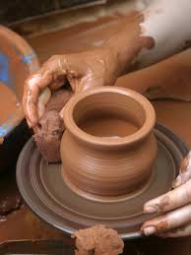
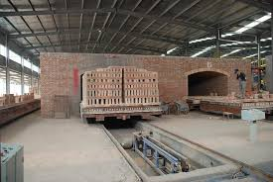
1. material preparation.
2. molding or casting
3. Thermal treatment of drying and heating

Slide 4
PREPARATION OF MATERIALS
Most products in so manufactured by particle agglomeration. The raw materials of these products vary depending on the required properties of the finished ceramic piece. Particles and other ingredients, such as foundations and lubricants can be dry or wet mixed. For ceramic products that do not need to have very critical properties, such as common bricks and sewer pipes and other clay products.

Slide 5
CONFORMING TECHNIQUES.
PRESSING. The ceramic raw material can be pressed in a dry, plastic or wet state inside a die to form products with a certain shape.
PRESSED IN DRY. This method is frequently used for refractory products (high thermal resistance material) and electronic ceramic components. This process can be defined as the simultaneous uniaxial compaction and the formation of a granulated powder together with small amounts of water or organic foundations of a die.
ISOMETRIC COMPACTION. in this process the ceramic powder is loaded into a flexible (usually rubber) sealed container (called a cartridge) that is inside a hydraulic fluid chamber that is applied pressure.

